Slide 1
Introducing the Agrifood Systems Technologies and Innovations Outlook (ATIO)
Christopher B. Barrett
Cornell University

Slide 2
Why an Agrifood Systems Technologies & Innovations Outlook (ATIO)?
Context: Must accelerate agrifood systems (AFS) transformation for multiple goals
Science, technologies and innovations (STI) key to accelerated AFS transformation
Data and assessments are scattered, incomplete, unintegrated
Objective: Open access knowledge product line w/ end-to-end life cycle coverage of AFS STI to inform public and private policymakers. A flagship biennial publication and Web portal curating data/analyses.
Key principles: Must offer:
National level, esp. for LMICs, as well as global coverage
An outlook, not mere snapshot of current patterns … need horizon scanning and foresight for the 5-20 yrs b/n R&D $ and impacts at scale. Can only manage phenomena one monitors.
Beyond science/engineering: Cover institutions, policies, etc. Current data coverage very uneven.
>70% consumer food purchase value added post-farmgate. Must move beyond primary production.

Slide 3
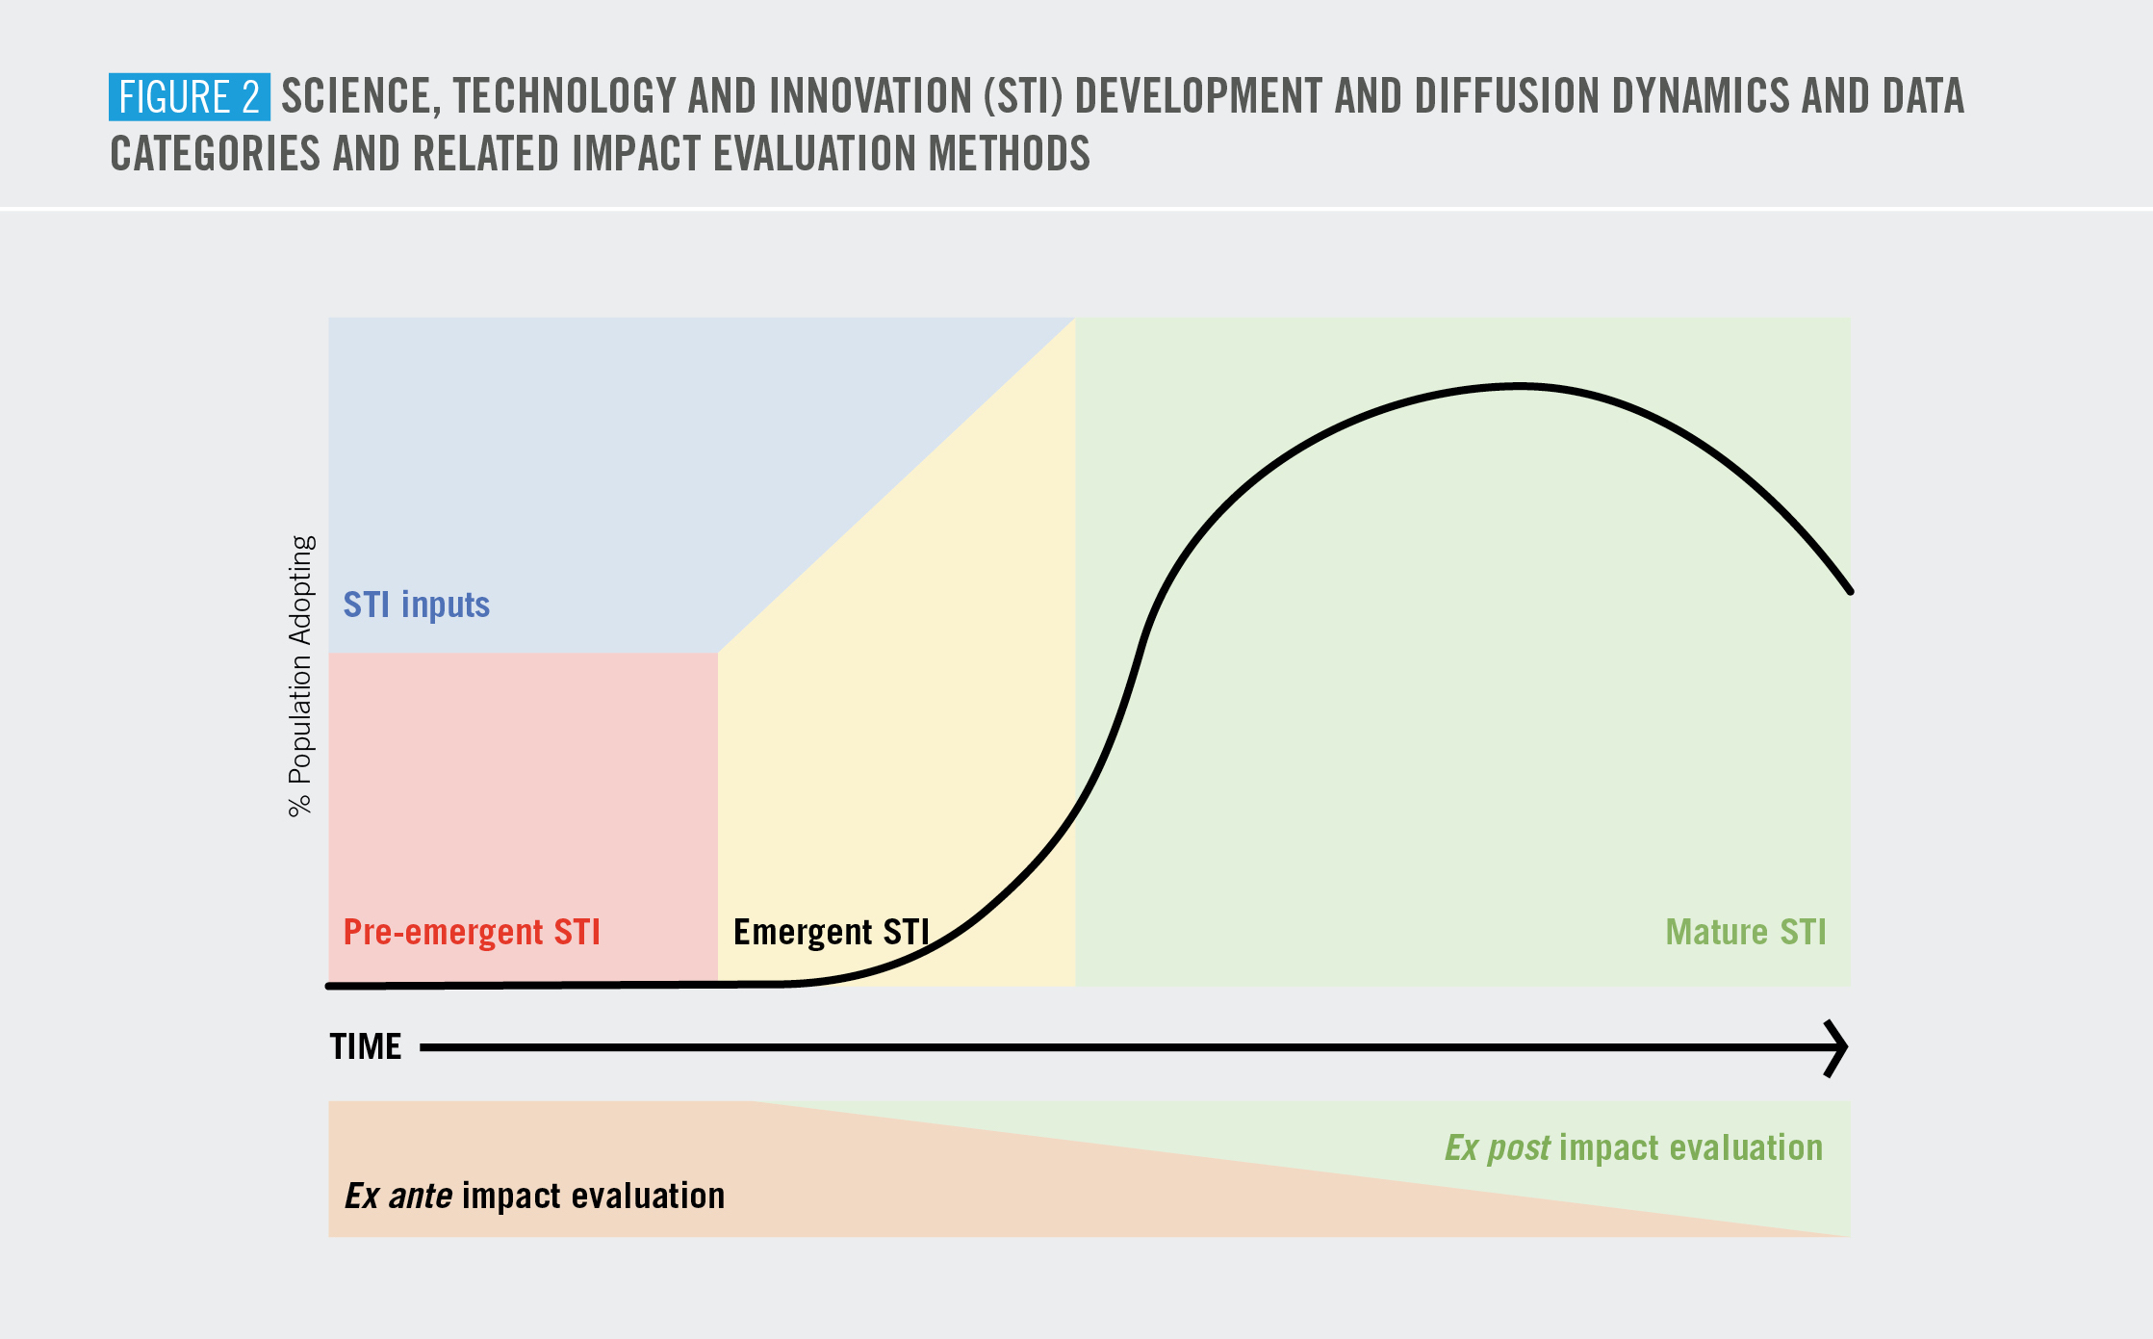
End-to-end STI life cycle coverage
STI life cycle stages vary in data availability/feasible collection methods, impact assessment methods.
End-to-end life cycle data production/curation/analysis must integrate sources and methods.
Supplement with curated evidence synthesis of impact assessments.

Slide 4
STI inputs and mature STI:
R&D $, human inputs (e.g., PhDs), material inputs (e.g., labs, genetic collections), policies, institutions
Multiple data sources exist: e.g., FAO, OECD, UNESCO, CGIAR-ASTI, etc.
Inclusion criteria for publicly available data on STI inputs/mature STI:
Data are available at country-level to permit internationally disaggregated analysis
There exist adequate recent data, meaning the series includes at least one data point from 2016-present for many (≥50) countries
The data series is inclusive, meaning strong (not necessarily universal) coverage of LMICs
The data source is reliable, meaning it uses peer-reviewed processes, comes from respected/credible organization, etc. – no advocacy group or journalistic material
A clear conceptual correspondence exists between the data series and AFS STI inputs
The data source offers a clear, credible, sensible definition of the variable
Double confirmation of inventoried data series, following best evidence synthesis practices.
Limited series currently available: 14 inputs, 17 mature meet criteria. Esp. thin post-harvest, institutions.

Slide 5
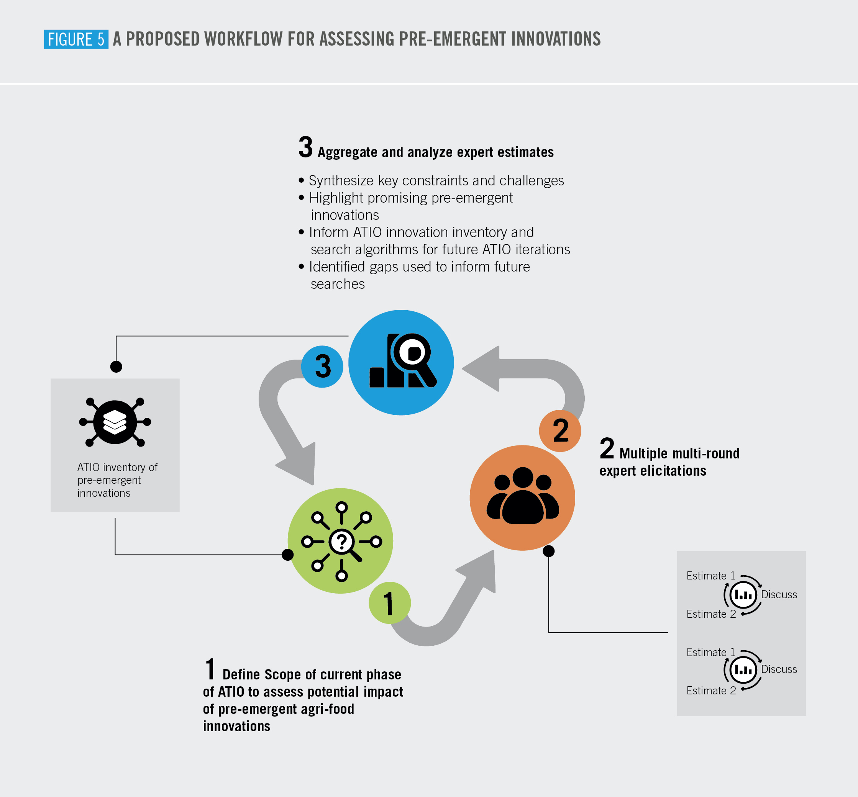
Pre-emergent/emergent STI (horizon scanning and foresight analysis):
Task: Iteratively inventory/assess (pre)-emergent STI using systematic, transparent methods
Challenges: Limited evidence, high uncertainty of potential impacts, needs broad coverage/expertise
Requires mixed methods using multi-round structured expert elicitations to assess:
Readiness for application to specific contexts
Suitability to address relevant objective(s) in specific geography, sector, and/or agrifood system
Scalability
Potential impact across key dimensions (livelihoods,
health, nutrition, environment, equity, etc.)
Iterative, continuous improvement in methods of collecting/
assessing (pre)-emergent innovations based on prior ATIO rounds
Map contextualized impact pathways

Slide 6
Evidence synthesis for integrated impact assessment
Descriptive stock-taking is necessary but not sufficient. Need assessment evidence w.r.t. various targeted impacts of AFS transformation. But impact assessment evidence highly dispersed and uneven quality.
Collect, curate and synthesize ex ante and ex post impact assessment evidence on AFS STI.
Interacts dynamically with expert elicitation, foresight and tradeoffs analysis.

Slide 7
Vision:
ATIO becomes the central periodical reference globally on how STI transform AFSs and to accelerating/scaling STI impacts to advance local, national and global goals and pathways.
Target audiences (esp. in LMICs):
Senior policymakers/advisers in countries/multilateral agencies
Public, private, and philanthropic investors in AFS STI (R&D and diffusion)
Requires:
Non-technical messaging supported by high-quality technical research
A consortium to tap distributed comparative advantage in data collection/curation/analysis and build community of (best) practice in foresight/tradeoffs analysis, impact assessment, evidence synthesis, etc.
Firewall b/n technical analysis and political uses/pressures to safeguard product integrity
Partner w/major OA scientific publisher (incentive effect for researchers, diffusion effect for users)

Slide 8
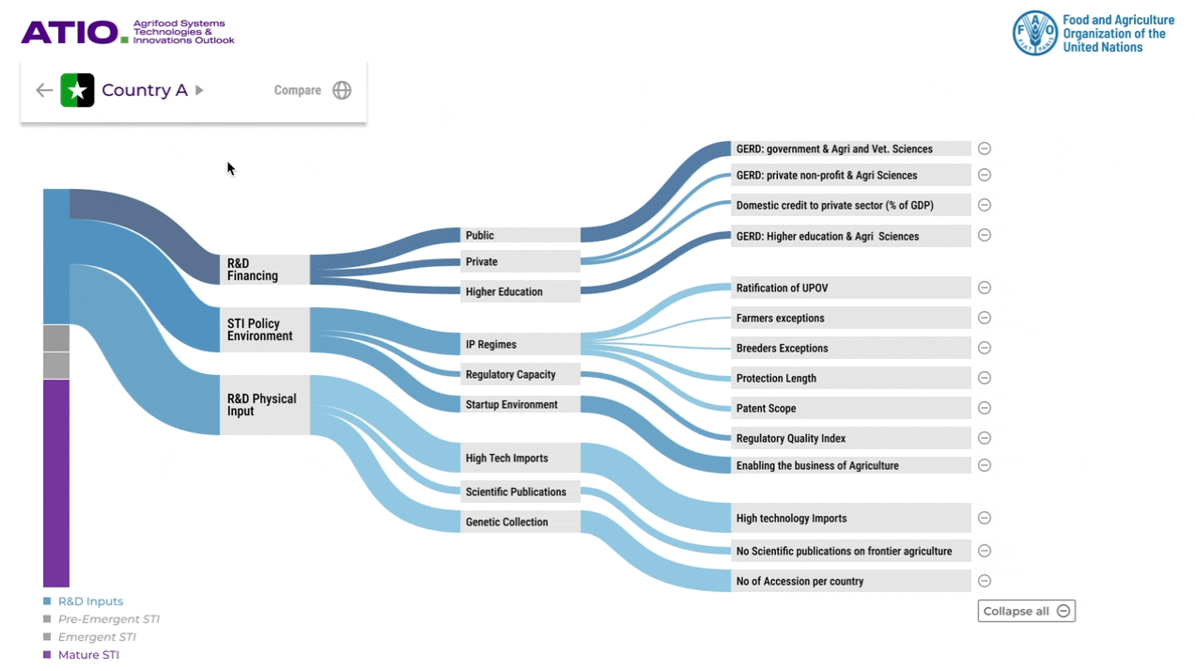
Open access data product line, not just a report:
Biennial publication. Supported by data and evidence synthesis portal updated regularly.
Induce investment to plug gaps.

Slide 9
THANK YOU

Slide 10
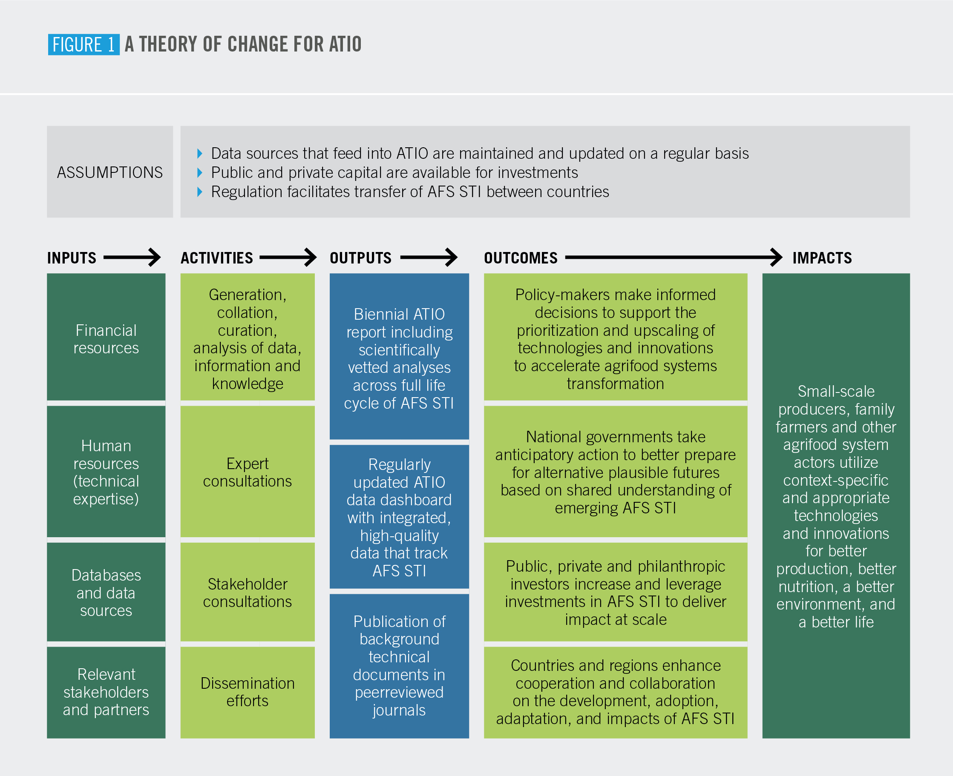
Contribute to FAO’s Science and Innovation Strategy by:
Strengthening science and evidence-based decision making through an improved evidence base on emerging innovations
Supporting regional and country-level innovation through sharing of knowledge of critical inputs for the adoption and scaling of AFS innovations
Reinforcing FAO capabilities in the knowledge management of AFS innovations and through efforts to disseminate this knowledge strengthen collaborative networks

